Slide 1
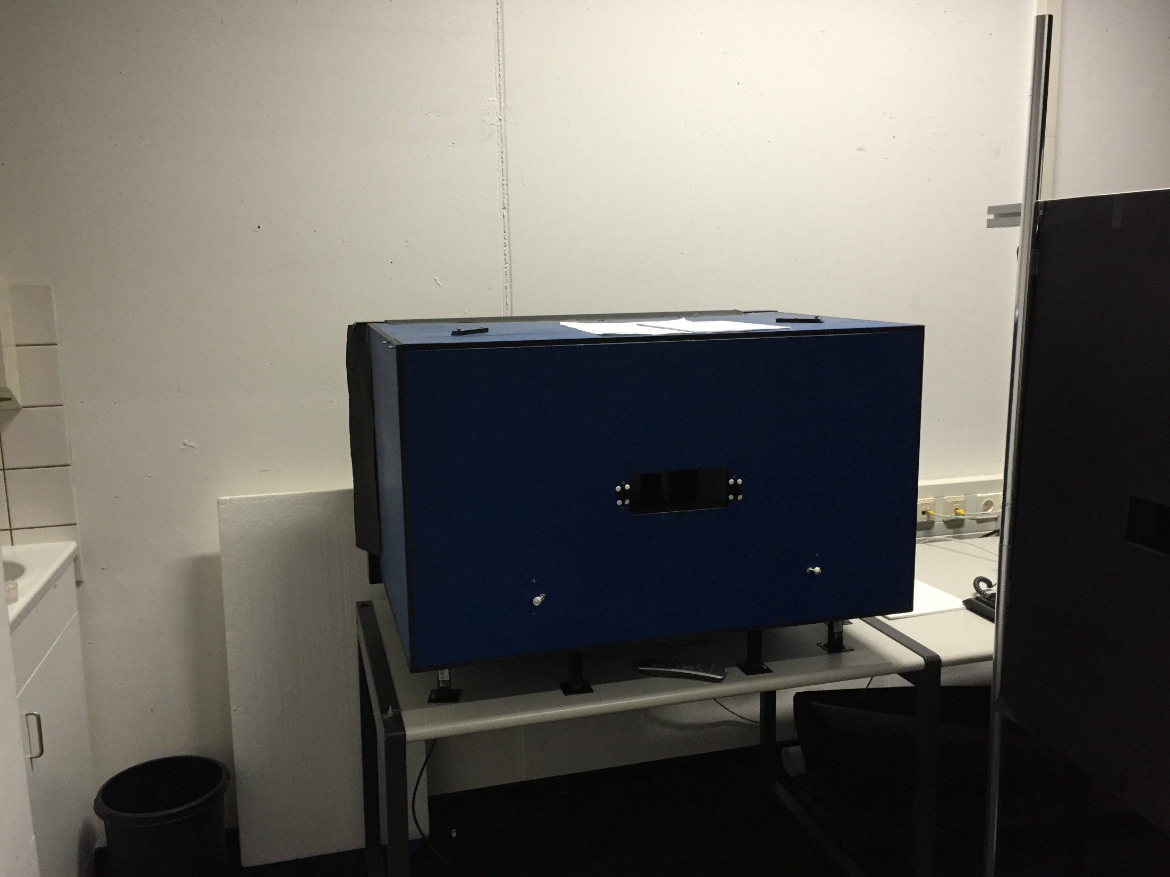
Enclosure box
LCD display
View aperture

